Slide 1
06/28/2024 A Review of Photogalvanic Effect
Review of SHG(we could skip it)
Photogalvanic: Perturbation theory
Defect states
Defects, Oxygen Vacancy, exact contributor to defect states
Resonator case(see if time permits)

Slide 2
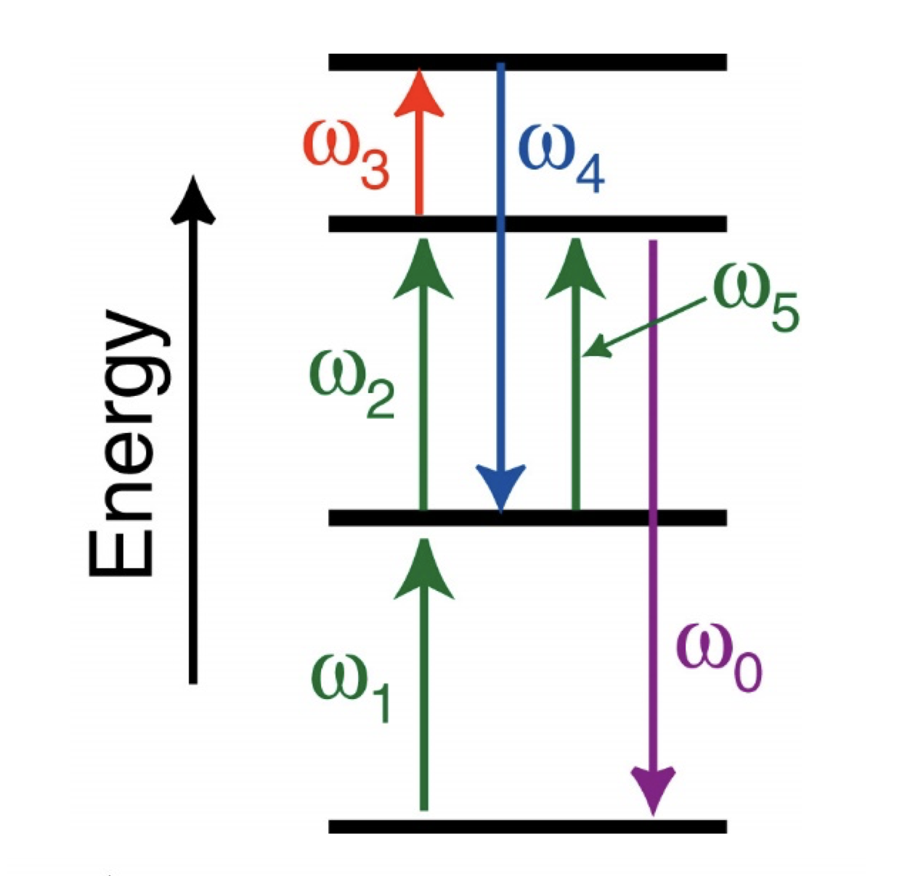
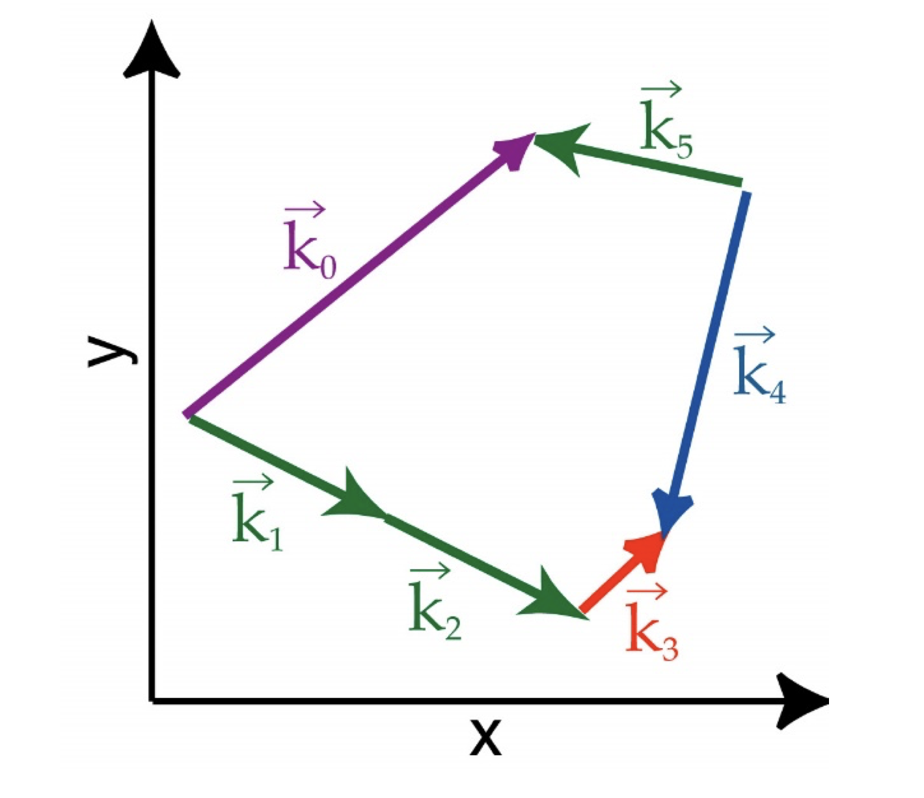
Nonlinear Optics Reaction in General
Phase Match ≡ Meet both constraints at the same time
Constraint 1:
Constraint 2:

Slide 3
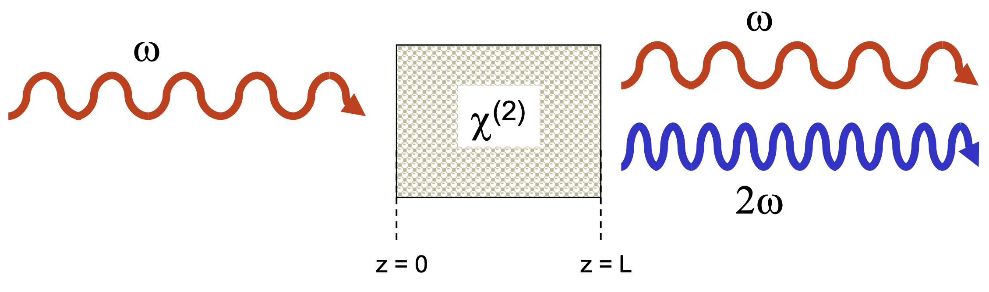
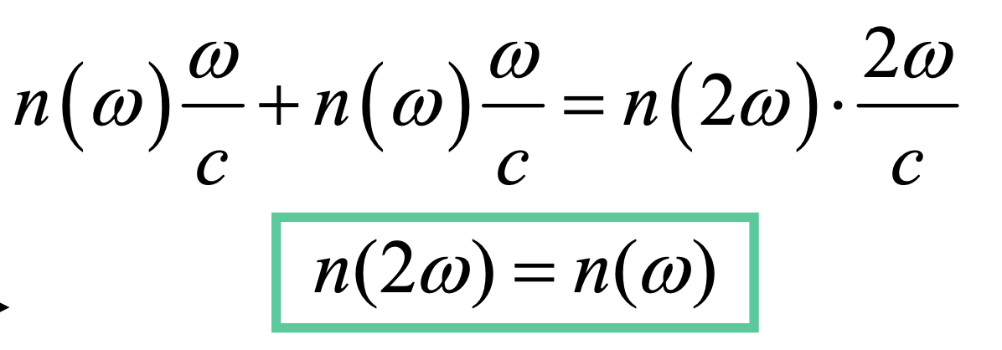

Second Harmonic Generation and χ⁽²⁾
Can‘t happen in centrosymmetric material(material with one refractive index)
Requires material to be birefringent(non-zero χ⁽²⁾)
z

Slide 4
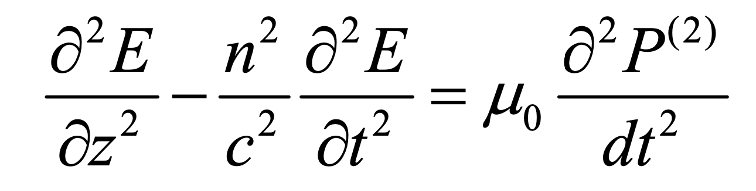
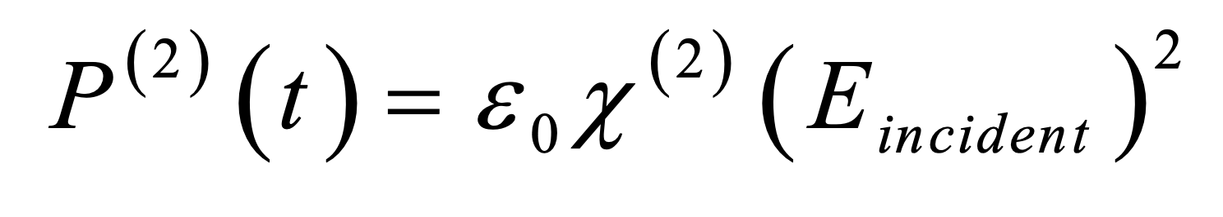
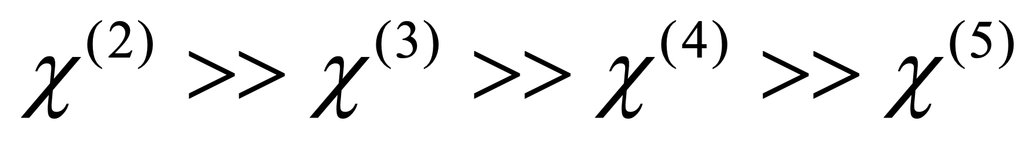
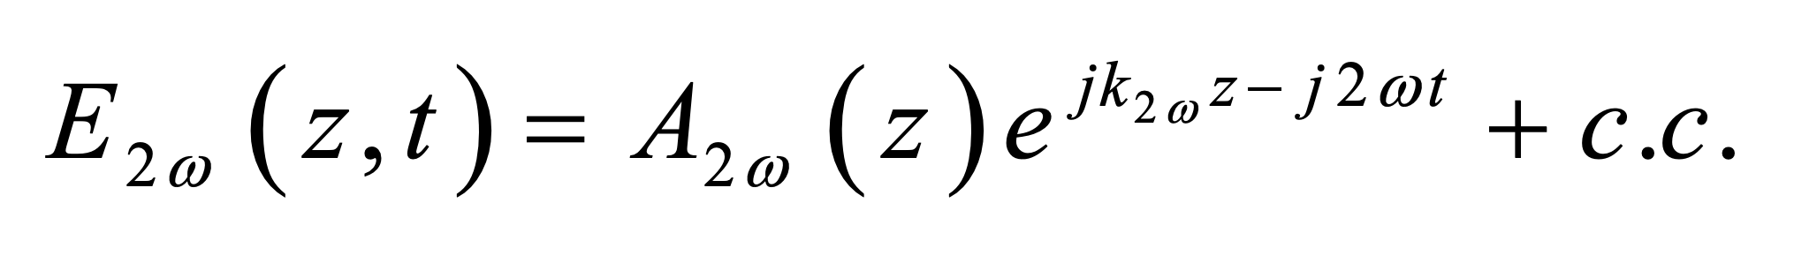
Solve the amplitude of 2nd harmonics: f(z)
The wave equation with χ⁽²⁾ nonlinearity:
Assumptions:
1:
2: Only SHG happens(other second order reactions does not)
3:

Slide 5
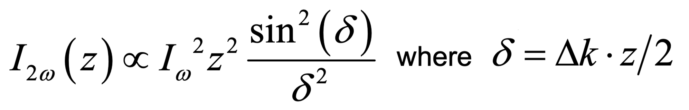
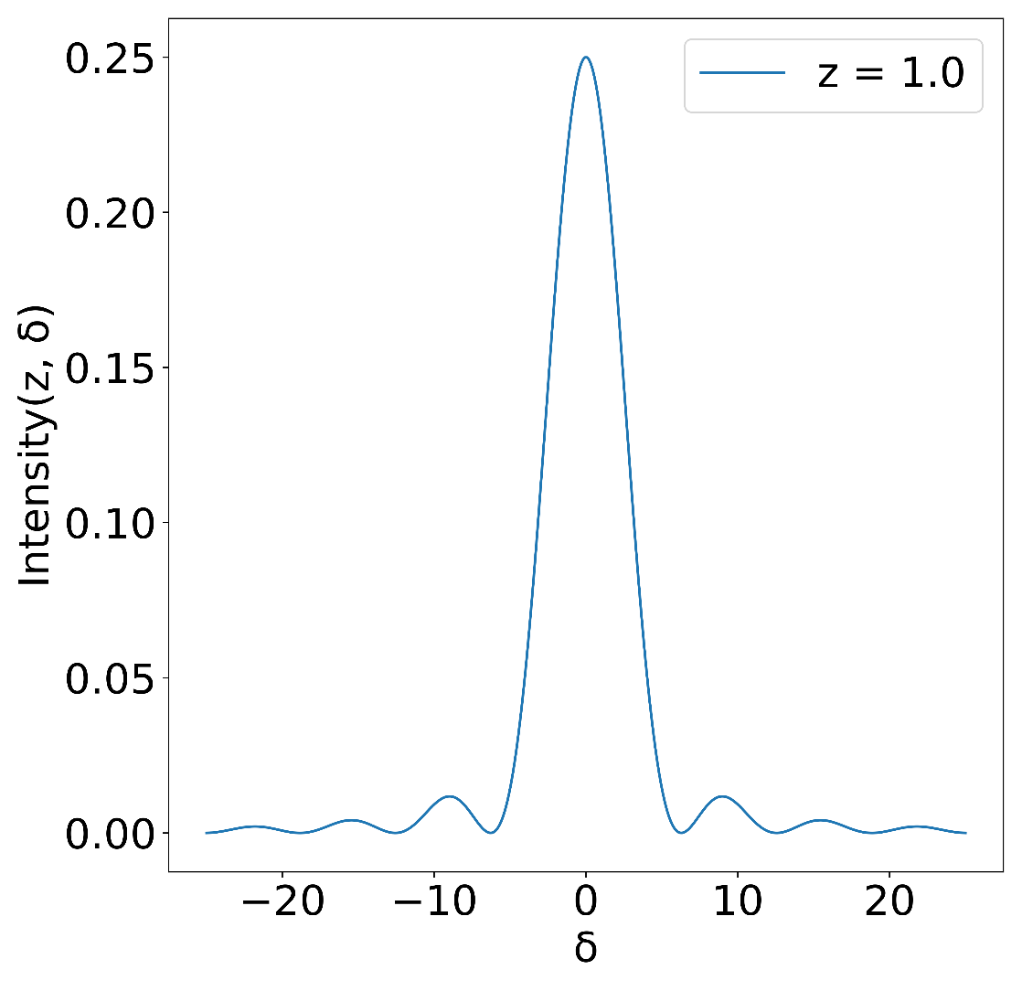
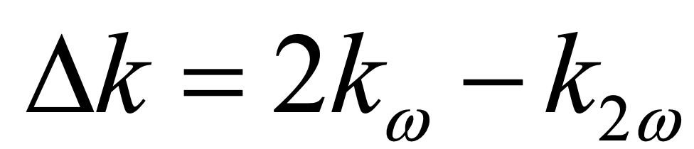
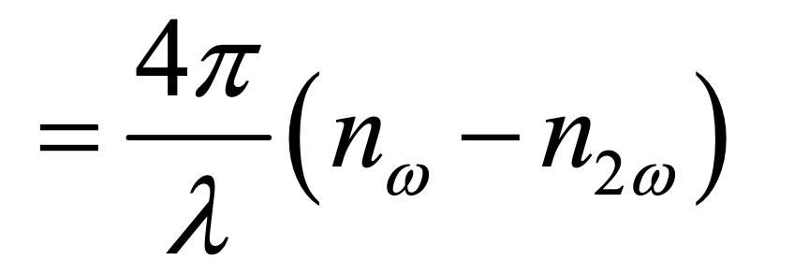
The solution
χ⁽²⁾
2nd harmonics power
χ⁽²⁾
Pump intensity
Phase ”δ”

Slide 6
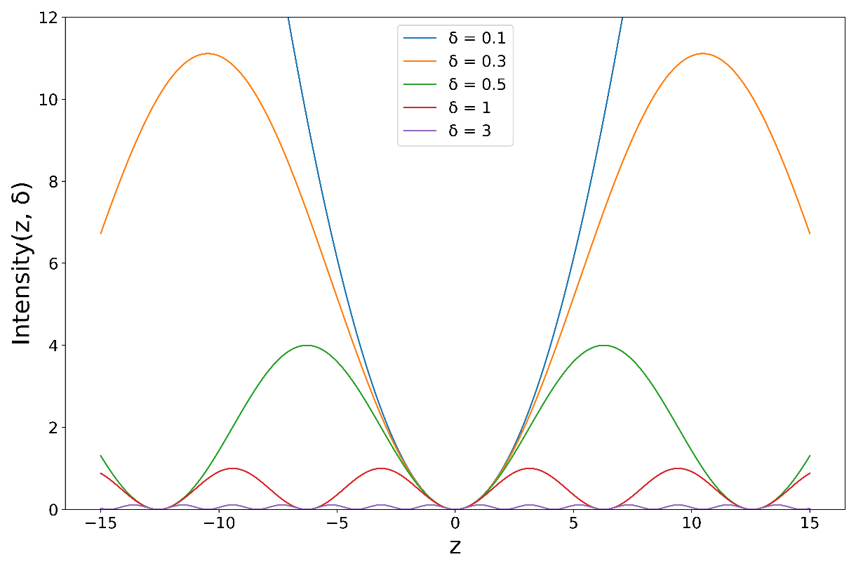
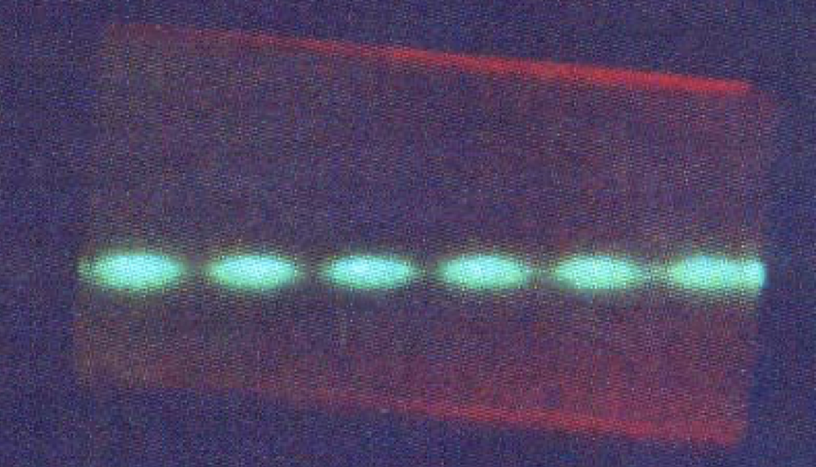
Quasi Phase Match
It is hard to match phase perfectly
When the phase misalignment goes above a threshold:
Oscillation between |w> and |2w> happens
SHG efficiency drops
In LiN, Quasi-Phase Match:
Manually flip the phase periodically by engineering the material

Slide 7
If material has no χ⁽²⁾ naturally,
can I still generate SHG in it?
Notes:
Centrosymmetric
Hard to do phase match

Slide 8
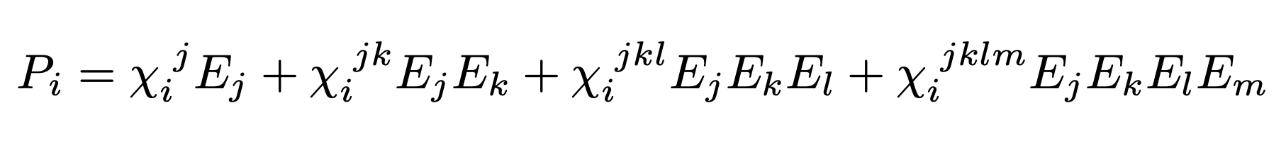
Susceptibility in tensor notation
χ^{(n)} is an (n+1) tensor
From pure tensor contraction:
χ⁽²⁾_{fake} = χ_{i}^{jk}_{fake} = χ_{i}^{jkl} E_{l}
χ⁽²⁾ could be constructed by any (2+n) tensor with n static E-field
Contribution from χ⁽²⁾ dominates:

Slide 9
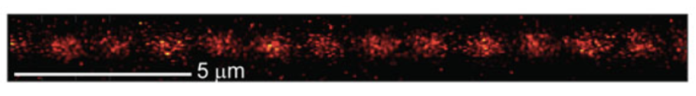
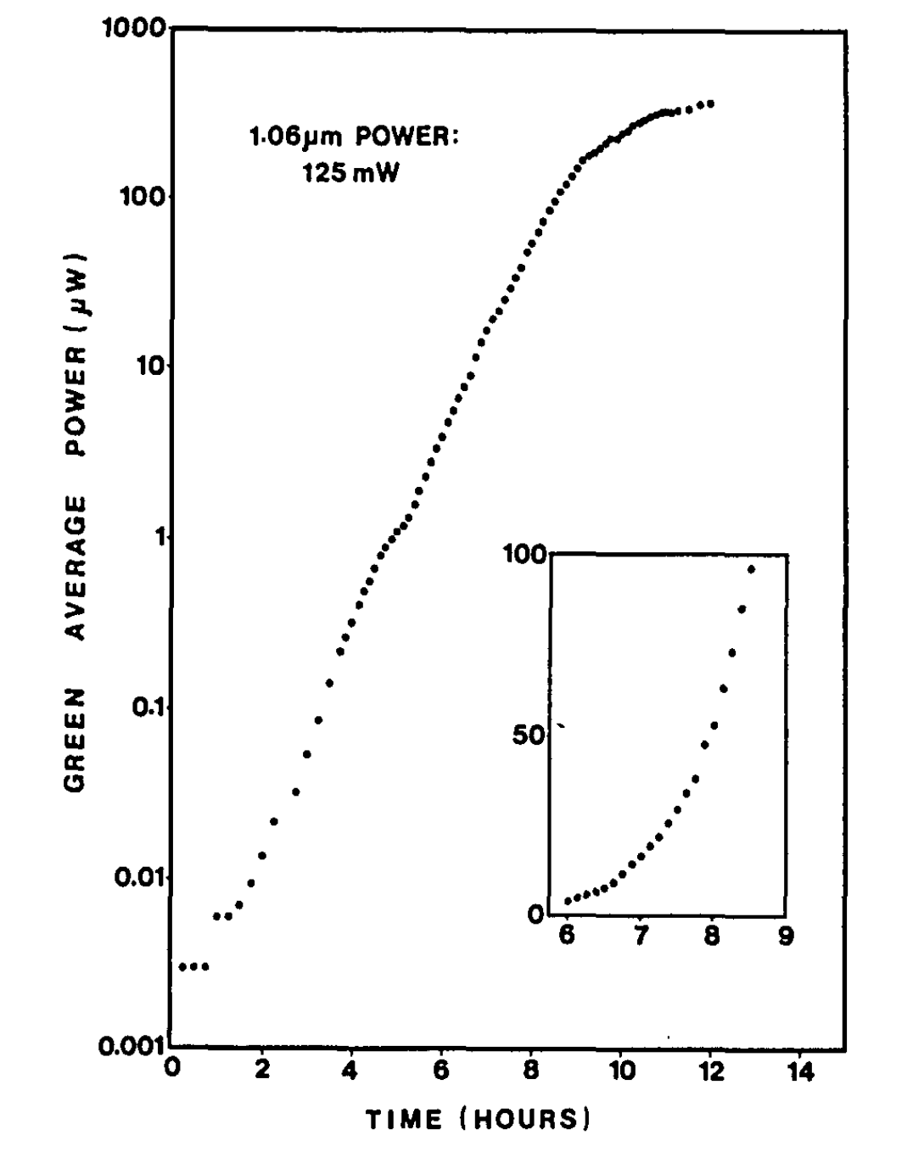
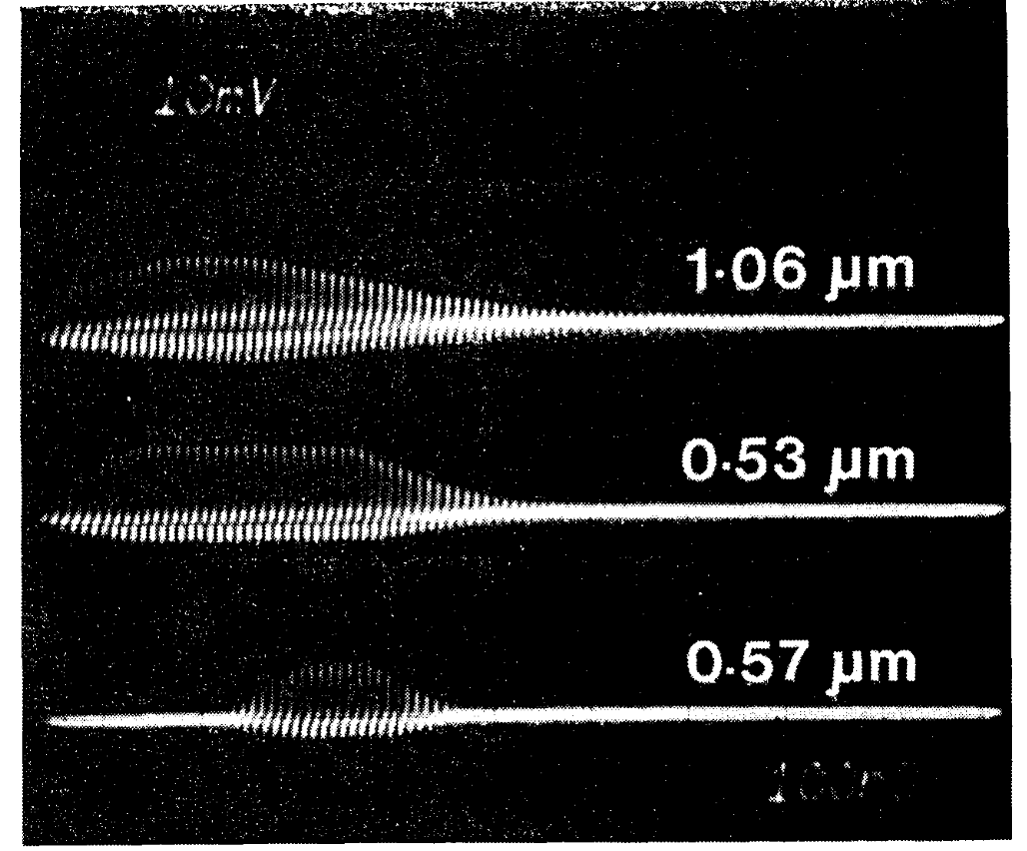
First Observation of SHG in glass fiber
O Yakar, E Nitiss, J Hu, CS Brès Laser & Photonics Reviews, 2022
Osterberg U, Margulis W Opt. Lett. 11 516 (1986)

Slide 10
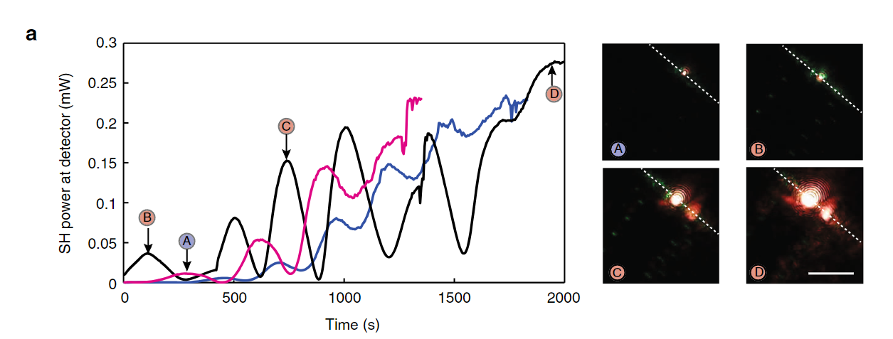
Observed 2nd Harmonics in SiN waveguide
Pink = 1539 nm
Blue = 1544 nm
Black = 1549 nm
SHG, red light
THG, green light
1539 nm (magenta line), 1544 nm (blue line) and 1549 nm (black line).
Notes:
In fact, green photons with a ~2.4 eV energy are able to directly re-ionize the electrons trapped in acceptor states below the conduction band28. Such a linear absorption process does not lead to any preferential emission and the electrons just move accordingly to the EDC, opposite to the direction of the photogalvanic current. Moreover, CPE can also involve multi- photon coherent interference from one pump photon and one photon at the THG frequency, albeit with the wrong periodicity. We therefore ascribe the oscillations observed during the growth of SHG in waveguide (i) to the counter-acting effects of CPE involving photons from THG and direct re-ionization also due to third harmonic photons.

Slide 11
χ⁽²⁾_{fake} = χ_{i}^{jk}_{fake} = χ_{i}^{jkl} E_{l}
If the grating is spatially periodic
what could be the E field that contributes to it?

Slide 12
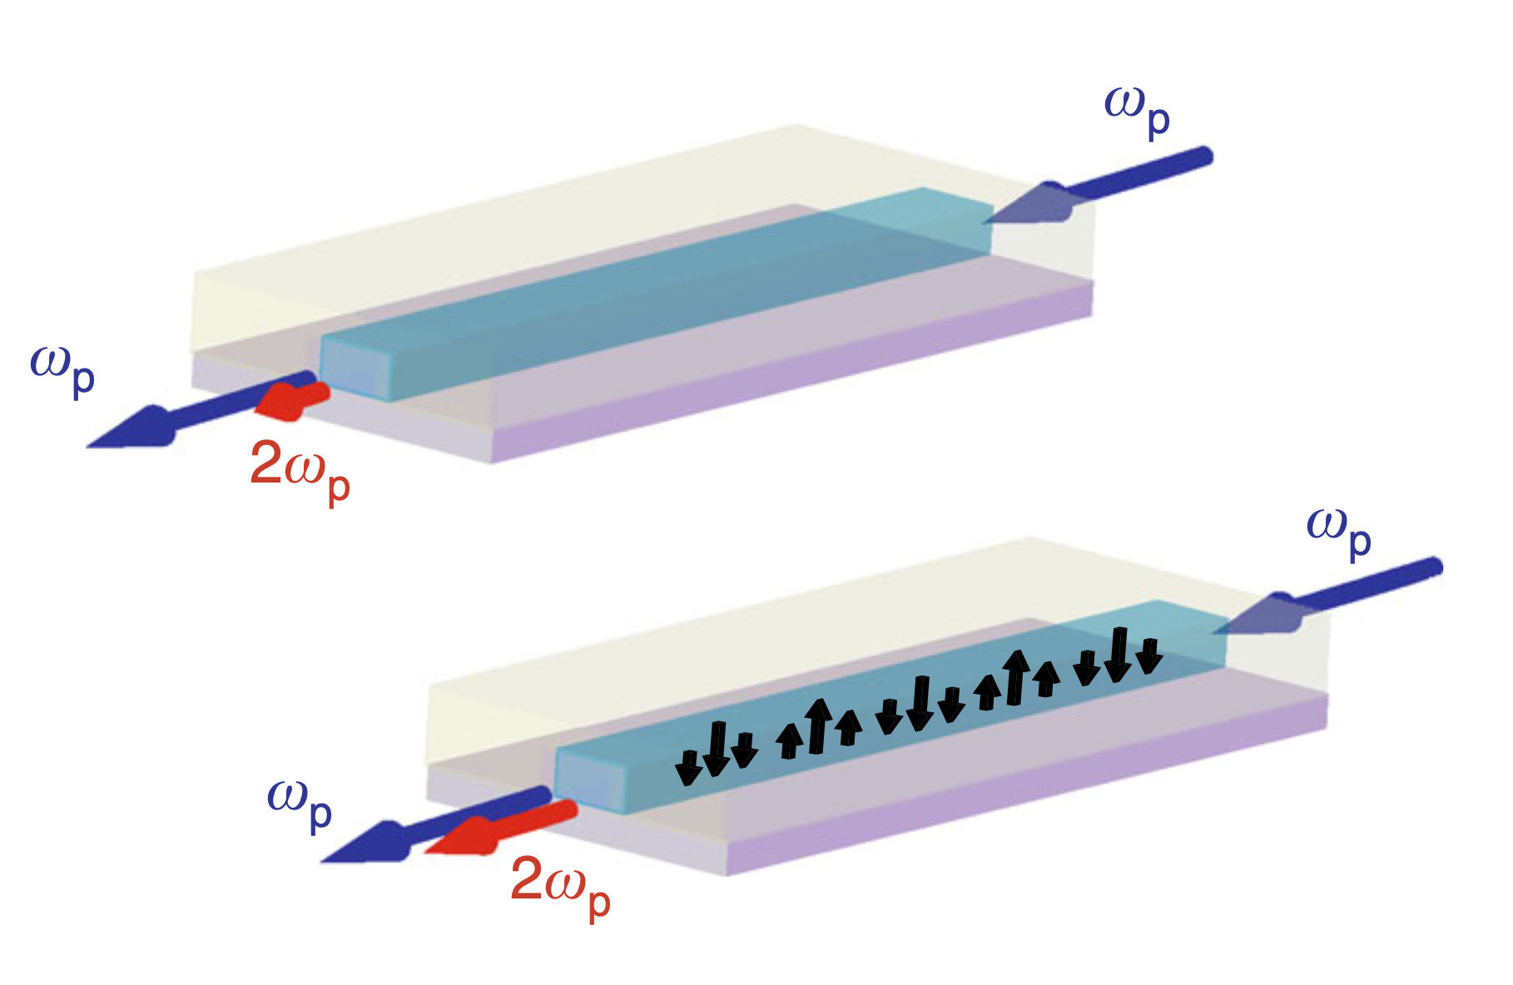
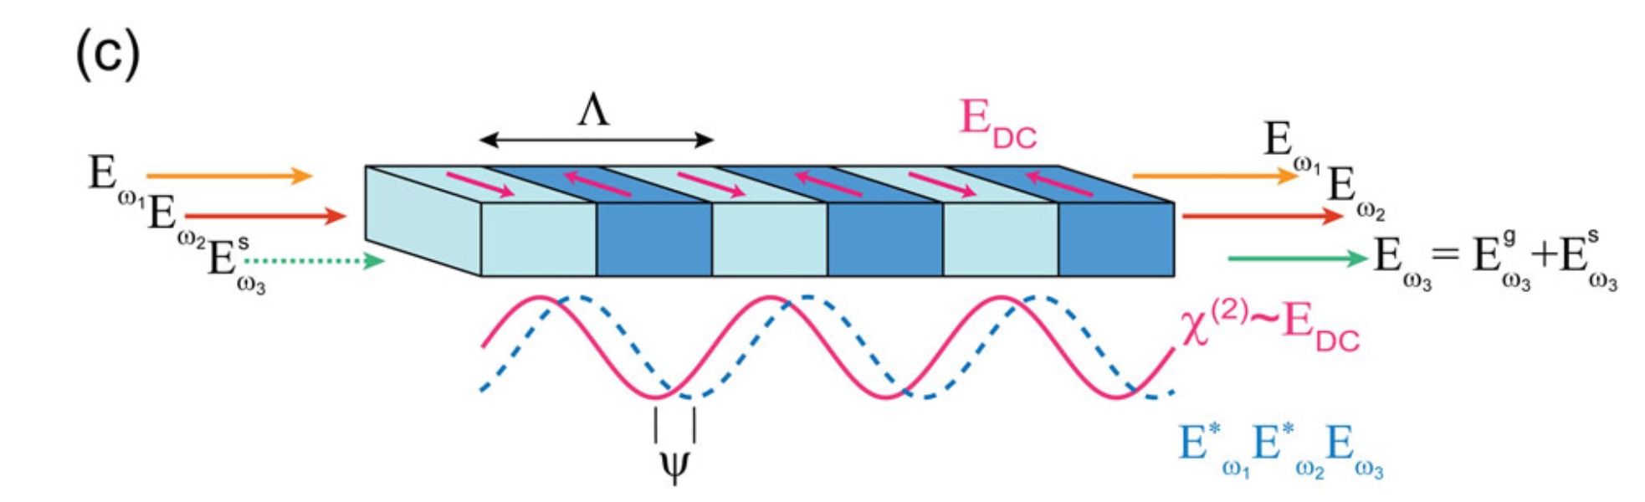
Spatially Periodic Charge Separation
A Billat, D Grassani, MHP Pfeiffer, S Kharitonov, TJ Kippenberg, CS Brès
Nature communications, 2017
O Yakar, E Nitiss, J Hu, CS Brès Laser & Photonics Reviews, 2022

Slide 13
Jargon Definition(This is just a menu.)
Defect := locally does not obey crystal symmetry
Defect State := eigenstate for the local Hamiltonian(Depends on how strong the local Hamiltonian coupled to the environment )
Configuration := the geometry of the bonds and atoms
Illuminate := Use a light to shoot your sample
Fundamental := |w>
Pump := |w>
Second harmonics wave := |2w>
Trap Site := Defect state
Write := Action to produce χ⁽²⁾_{fake} grating. Typically mean : Use |w,1064> and |2w,523> to illuminate a sample
Read := Action to generate SHG |2w>. Typically mean use |w,1064>. To illuminate a sample
Erase := Action to remove χ⁽²⁾_{fake} grating. Typically mean: Use |2w, 523> to illuminate a sample
Seeding :=Action to produce χ⁽²⁾_{fake} grating. Specifically mean to use |w,1064> and |2w,523> to illuminate a sample

Slide 14
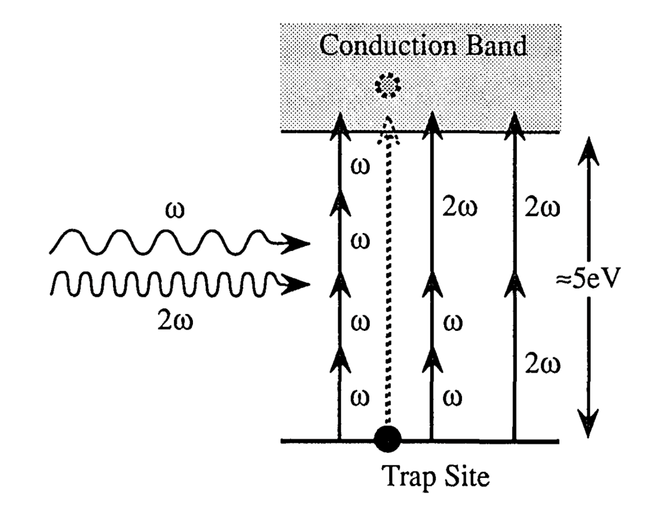
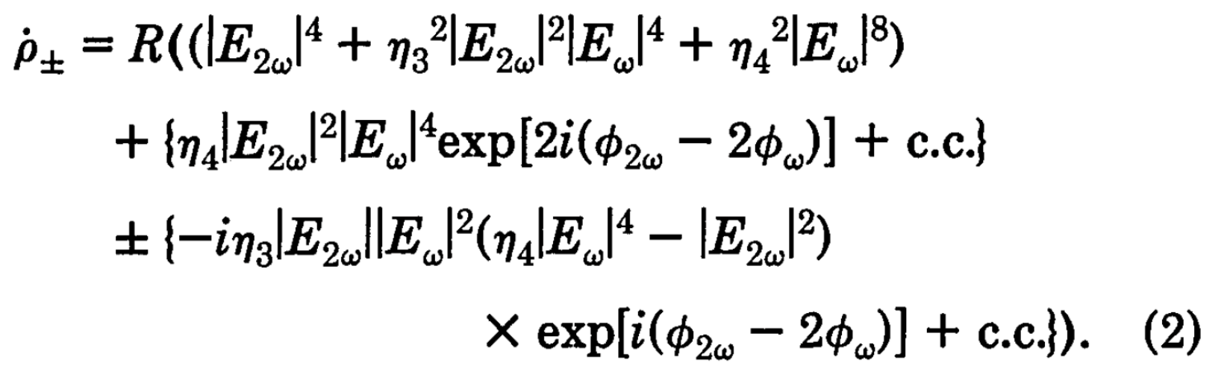
Charge Separation: Photogalvanic Effect
A quantum model
Quantum Interference(cross term) among different paths
Perturbation applied to 4th order(otherwise can’t see it)
Uneven transition rate
Donor: (lower energy level defect)
Defect state 1(Trap site) ← →Conduction band
Receiver: (higher energy level defect)
Conduction band ← → Defect state 2(not shown here)
For glass
DZ Anderson, V Mizrahi, JE Sipe Optics letters, 1991•opg.optica.org
Notes:
Quantum interference (product term in n-th order perturbation coefficients)
Recent evidence4 suggests that the induced x()) is in fact the result of some internal dc e1ectrie field acting on there J) of the glass
Such a de electric field would perhaps come from charges released from certain defect sites in the glass, and trapped at other sites. This picture has been suggested by several worker

Slide 15
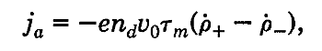
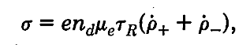
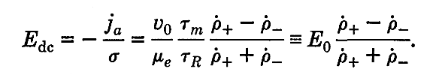
Photogalvanic Effect: Charge Transport Model
Difference: Charge in the conduction band
V₀: Initial speed when kicked out
Τ_{m} : Time when exciton decoheres
Sum: Electron holes both will move under E
n_{d}: density of sites
Τ_{R} : Time when electron is trapped again
Ohmic: J = б E
Just a capacitor
Help: why omic necessarily?

Slide 16
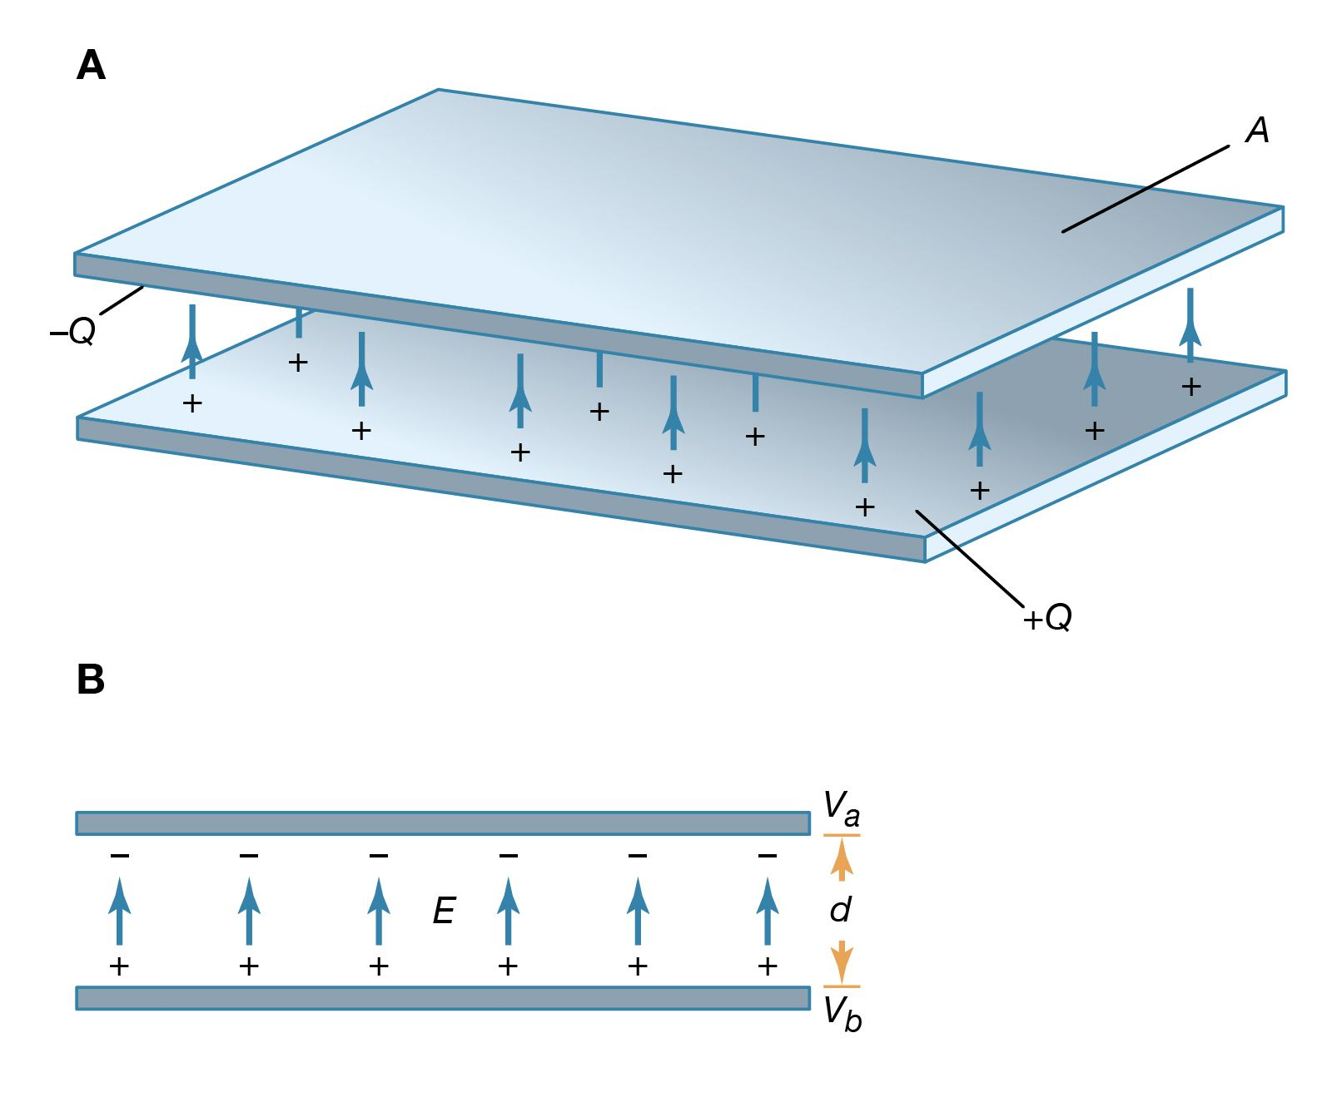
An Analogy
This is a classical capacitor
This is a quantum version capacitor
Defect State with higher energy(e receiver)
-
-
-
CB
+
+
+
Defect State with lower energy(e donor)

Slide 17
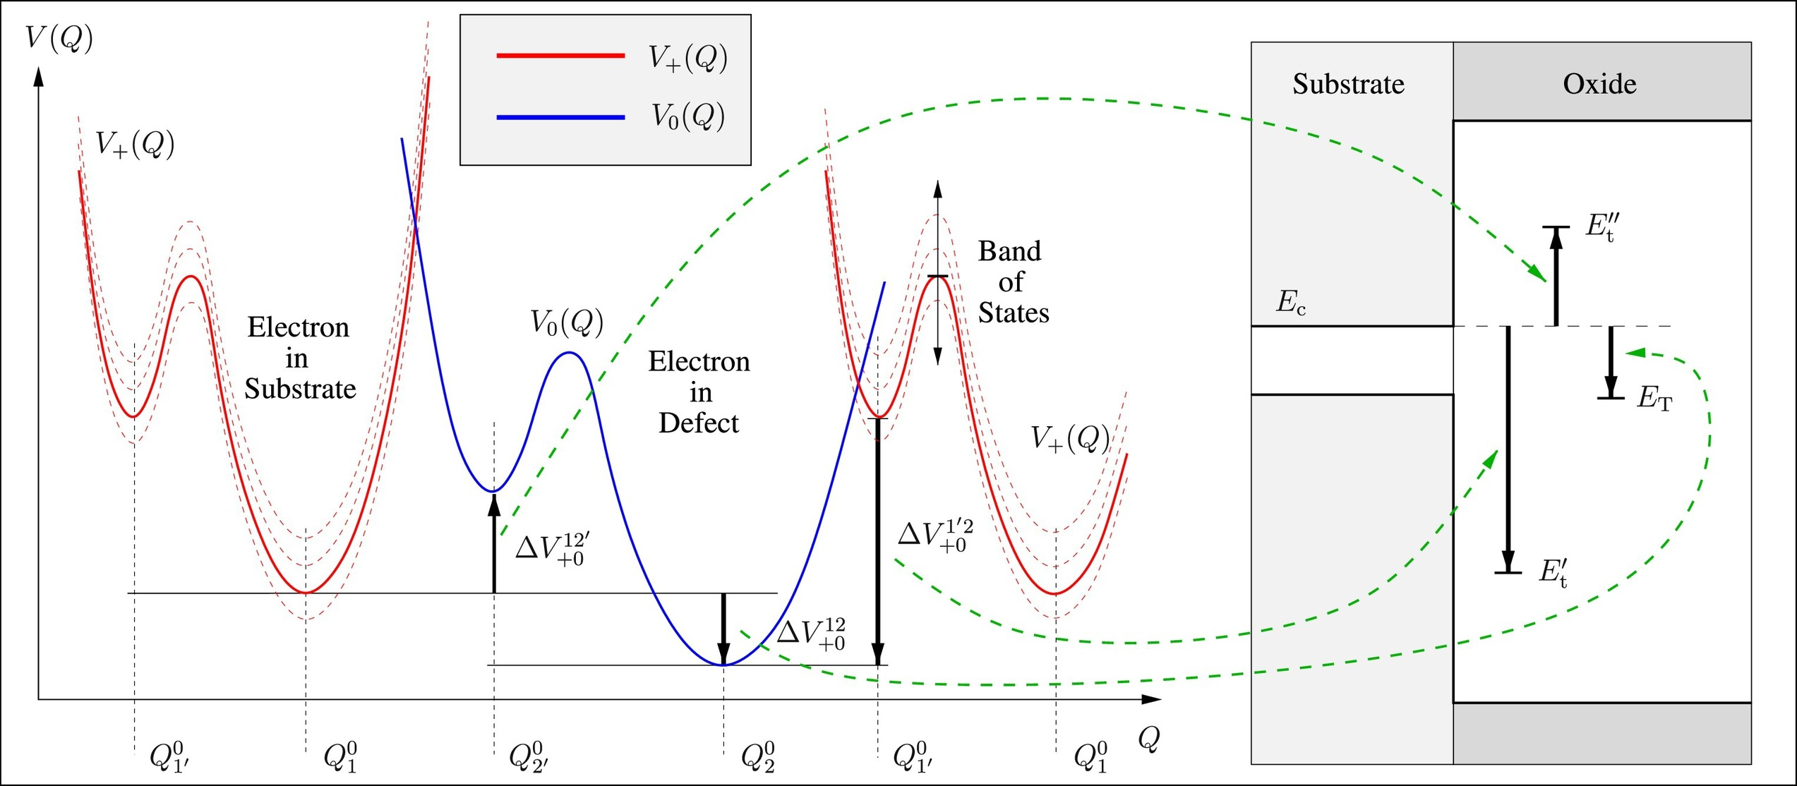
Another Analogy—Global/local electron Trap
A random picture of a band diagram that contains a global and local trap I found from some molecular computational physics journal

Slide 18
What do I mean by “defect”?

Slide 19
Jargon definition
Defect := locally does not obey crystal symmetry
Defect State := eigenstate for the local Hamiltonian(Depends on how strong the local Hamiltonian coupled to the environment )

Slide 20
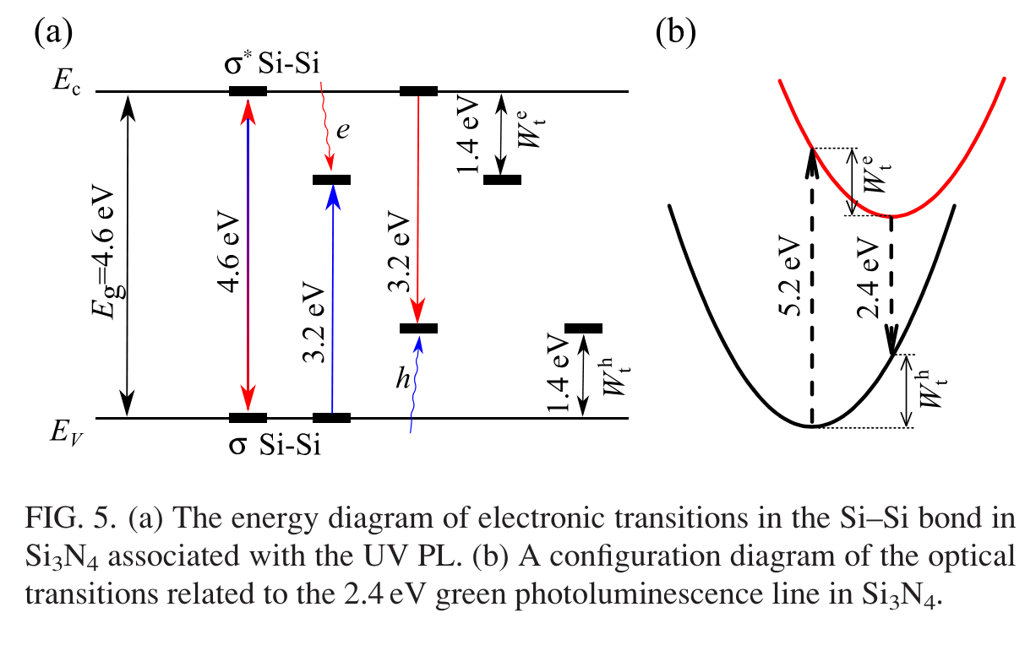
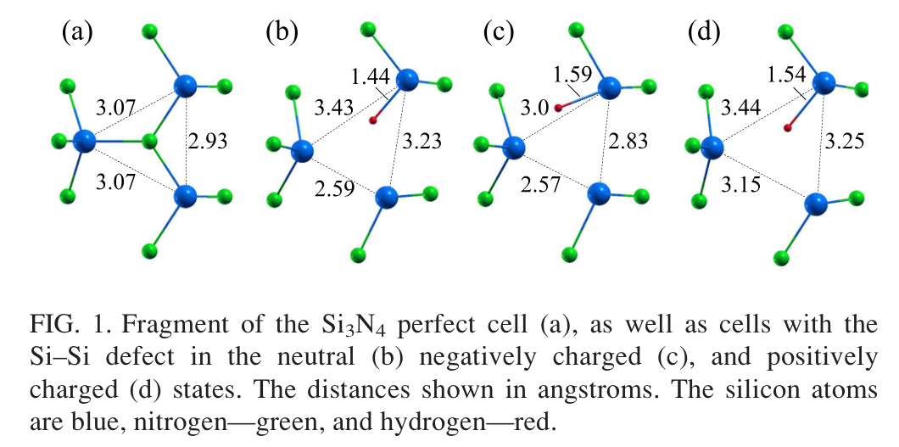
What do I mean by “defect”?: Example 1
For SiN
Popular belief:
The defect in SiN is from vacancy
They call it “Memory Effect”
Defect State := eigenstate for the local Hamiltonian
Defect := locally does not obey crystal symmetry
VA Gritsenko, TV Perevalov, OM Orlov… - Applied Physics …, 2016 - pubs.aip.org

Slide 21
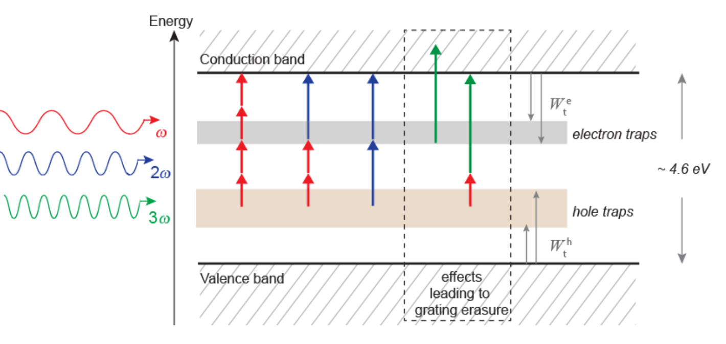
What do I mean by “defect”?: Example 1
Pink = 1539 nm
Blue = 1544 nm
Black = 1549 nm
Oscillation:
1. |1500> | 750> are writing (writing means sending electrons to the prison)
2. |500> is erasing (erasing means helping trapped electrons to escape)
3. They are fighting against each other

Slide 22
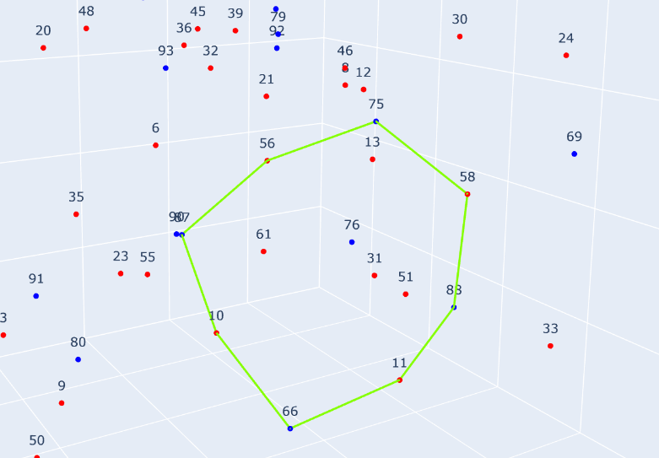
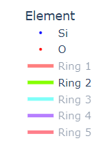
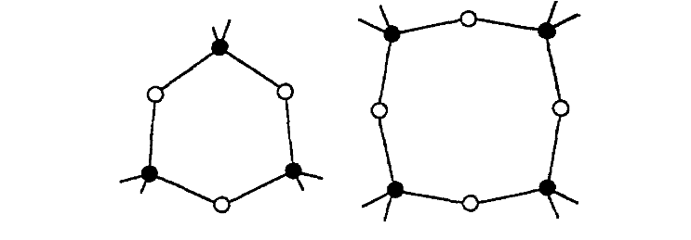
What do I mean by “defect”?: Example 2
Will specifically expand more from the perspective of oxygen vacancy later,
as defects in GeO2 are crucial to our project
Some crazy theorist uses “ring” topology to argue for defect
GeO2-related defects
JM Gabriagues, H Fevrier - Optics letters, 1987 - opg.optica.org
Notes:
Trapping Mechanism and Persistence
Trapping in SiN: In SiN, nitrogen vacancies saturated with hydrogen atoms (leading to Si–H and Si–Si bonds) act as traps for both holes and electrons.
Trap Energies: Electron and hole traps are located inside the ~4.6 eV bandgap of SiN, around 1.4 eV from the conduction and valence bands, respectively.

Slide 23
As we currently do not see SHG in the resonator,
what could be the reason from the bandgap side?

Slide 24
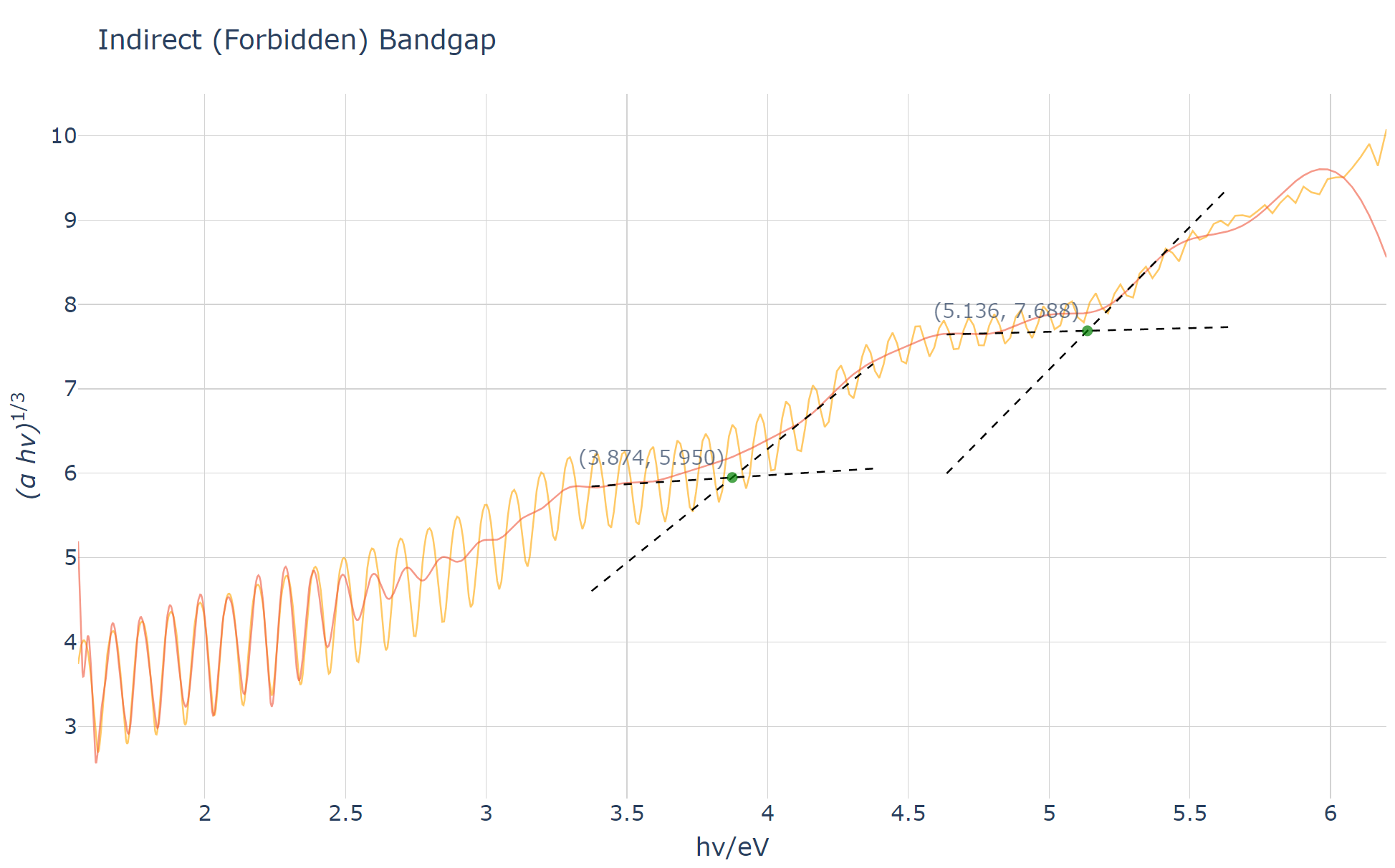
Trap site for GeO₂-SiO₂
CB
5.1 ev
9 ev
Defect 1
3.8 ev
NB
Data obtained by Haojing and fitted by me
Notes:
matched χ(2)\chi^{(2)}χ(2) grating in the fiber (L2ω∝A2P0nL_{2\omega} \propto A^2P_0^nL2ω​∝A2P0n​), and then some of this light is absorbed through two-photon absorption (∝P02\propto P_0^2∝P02​). This TPA would, in this picture, result in the release of the trapped charges which are responsible for the internal macroscopic dc field that gives rise to the χ(2)\chi^{(2)}χ(2). Since the effect is almost absent in fiber B, we presume that such TPA is germania related. Note that the erasure process of Ouellette et al., described by Eq. (1), which is quartic in the green power as compared with our quadratic dependence, is ignored in Eq. (2) due to the relative weakness of the generated SH, as compared with the seed green intensity.
A broad linear absorption band centered at 245 nm is known to exist in germania glass, and is well placed for TPA of the 532 nm light. While the defect structure responsible for this band is still the subject of discussion, it is considered to be due to an oxygen vacancy neighboring a Ge atom. This therefore suggests that the origin of the decay might be related to the local environment of the Ge atoms. Bonds such as −Ge−Ge−-Ge-Ge-−Ge−Ge− or −Ge−Si−-Ge-Si-−Ge−Si− are weaker than other bonds in silica glass (such as −Si−O−Si−-Si-O-Si-−Si−O−Si−), and may therefore be more easily affected by TPA of the 532 nm light. Furthermore, it should be noted that while the 1064 nm and 532 nm light together can create the SHG grating, the 1064 nm light alone erases the SHG grating in fiber A. For the SHG from irradiated fibers to be a function of the IR power, the grating has to be stable over the writing period.
The slope of the curves from 2(b), plus additional data vs 1064 nm power used during the reading phase of fiber A. The solid line is the result of a linear least-squares fit.
In conclusion, we have investigated SHG in a high germania content fiber, seeded with Q-switched mode-locked pulses at 532 and 1064 nm. The SHG from the fiber was observed to decay upon exposure to 1064 nm light alone, which we have not observed over short times in fibers with low GeO2 content. The decay rate was proportional to the fourth power of the 1064 nm power, which is consistent with a model based on TPA of the generated SH light. This result suggests that the germania is important in the decay. To obtain more stable SHG in fibers, and to understand its formation mechanism, it appears necessary to investigate the SHG of optical fibers with various GeO2 concentrations.
This research was supported by the Air Force Office of Scientific Research under AFOSR-87-0344, and by NTT laboratories. We wish to thank M. Shimizu of NTT laboratories for providing fiber B.

Slide 25
Trap site for GeO₂-SiO₂
(Think of it as a capacitor, I need someone to lose and someone to gain, to form charge separation)
Donor does not donate electrons :
What is Defect 1?
Can I engineer it to make it closer to conduction band?
Receiver failed or too easy to lose electrons:
What is Defect 2?
What is its density?
How easily is it to excite electrons away from it?
CB
5.1 ev
9 ev
Defect 1
3.8 ev
NB
Popular belief: Oxygen Vacancy around the Ge atom
Notes:
matched χ(2)\chi^{(2)}χ(2) grating in the fiber (L2ω∝A2P0nL_{2\omega} \propto A^2P_0^nL2ω​∝A2P0n​), and then some of this light is absorbed through two-photon absorption (∝P02\propto P_0^2∝P02​). This TPA would, in this picture, result in the release of the trapped charges which are responsible for the internal macroscopic dc field that gives rise to the χ(2)\chi^{(2)}χ(2). Since the effect is almost absent in fiber B, we presume that such TPA is germania related. Note that the erasure process of Ouellette et al., described by Eq. (1), which is quartic in the green power as compared with our quadratic dependence, is ignored in Eq. (2) due to the relative weakness of the generated SH, as compared with the seed green intensity.
A broad linear absorption band centered at 245 nm is known to exist in germania glass, and is well placed for TPA of the 532 nm light. While the defect structure responsible for this band is still the subject of discussion, it is considered to be due to an oxygen vacancy neighboring a Ge atom. This therefore suggests that the origin of the decay might be related to the local environment of the Ge atoms. Bonds such as −Ge−Ge−-Ge-Ge-−Ge−Ge− or −Ge−Si−-Ge-Si-−Ge−Si− are weaker than other bonds in silica glass (such as −Si−O−Si−-Si-O-Si-−Si−O−Si−), and may therefore be more easily affected by TPA of the 532 nm light. Furthermore, it should be noted that while the 1064 nm and 532 nm light together can create the SHG grating, the 1064 nm light alone erases the SHG grating in fiber A. For the SHG from irradiated fibers to be a function of the IR power, the grating has to be stable over the writing period.
The slope of the curves from 2(b), plus additional data vs 1064 nm power used during the reading phase of fiber A. The solid line is the result of a linear least-squares fit.
In conclusion, we have investigated SHG in a high germania content fiber, seeded with Q-switched mode-locked pulses at 532 and 1064 nm. The SHG from the fiber was observed to decay upon exposure to 1064 nm light alone, which we have not observed over short times in fibers with low GeO2 content. The decay rate was proportional to the fourth power of the 1064 nm power, which is consistent with a model based on TPA of the generated SH light. This result suggests that the germania is important in the decay. To obtain more stable SHG in fibers, and to understand its formation mechanism, it appears necessary to investigate the SHG of optical fibers with various GeO2 concentrations.
This research was supported by the Air Force Office of Scientific Research under AFOSR-87-0344, and by NTT laboratories. We wish to thank M. Shimizu of NTT laboratories for providing fiber B.

Slide 26
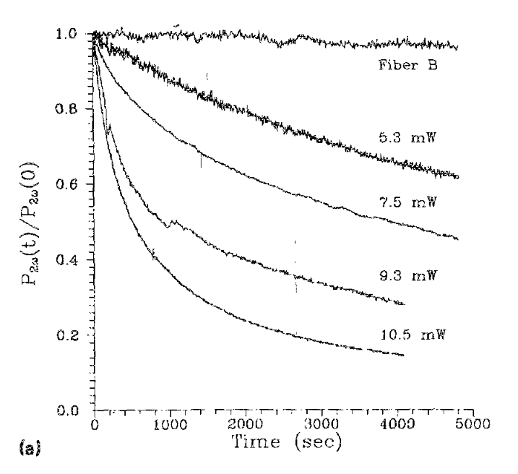
Trap site for GeO₂-SiO₂
B
Fiber A: High concentration GeO2 fiber
Fiber B: Low concentration
Both written by |1032> + |532> for 1.5h
High concentration leads to erasure even during reading(|1064>)
High concentration + high power = giga quick erasure of your grating during reading
A
A
A
A
Y Hibino, V Mizrahi, GI Stegeman, S Sudo - Applied physics letters, 1990 - pubs.aip.org

Slide 27
Trap site for GeO₂-SiO₂
B
This is an old paper, but it does point out that:
The defect is related to GeO2
A
A
A
A
Y Hibino, V Mizrahi, GI Stegeman, S Sudo - Applied physics letters, 1990 - pubs.aip.org

Slide 28
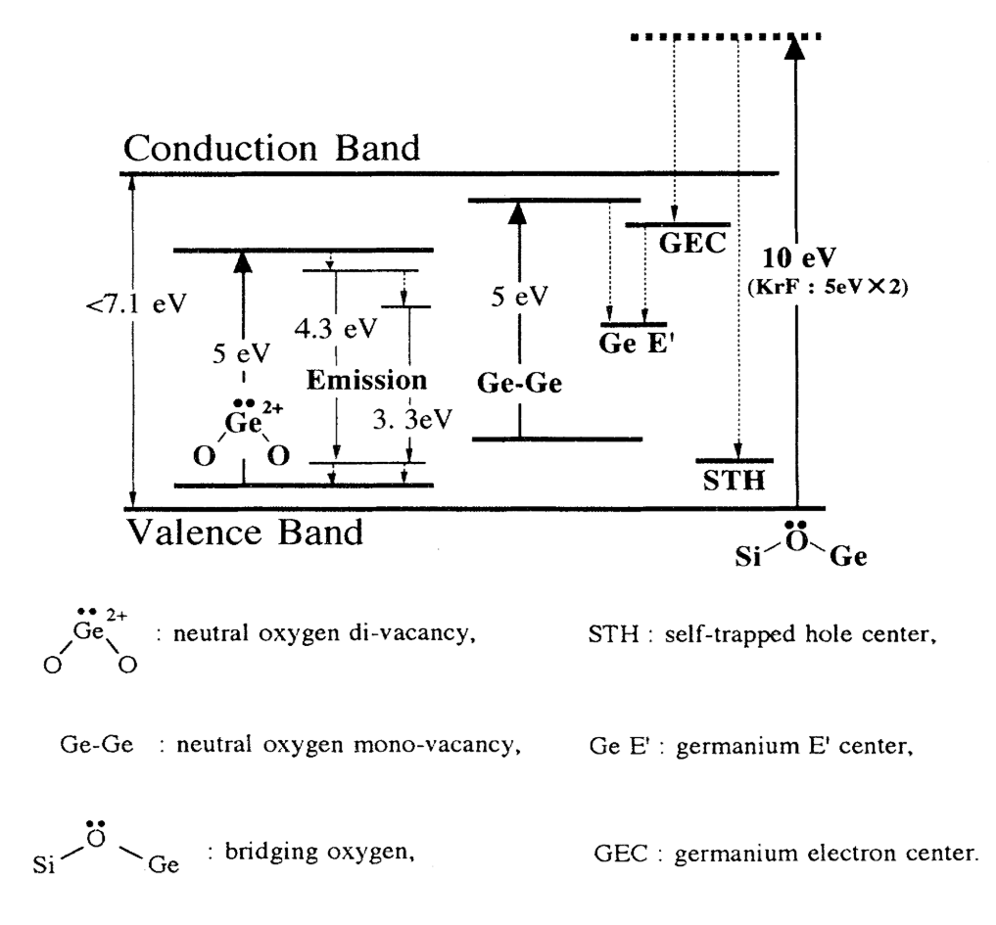
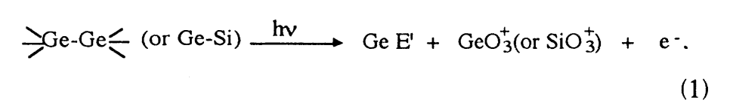
5GeO₂-95SiO₂
J Nishii, K Fukumi, H Yamanaka, K Kawamura, H Hosono, H Kawazoe
Physical Review B, 1995•APS
5ev

Slide 29
Jargon Definition 2
NOMV := Neutral Oxygen Monovacancy ; Donor ; absorb 5 ev
NODV := Neutral Oxygen Divacancy ; Donor ; emit 3.2/4.3 ev
Ge E’ := Germanium E' Center; Oxygen-deficient center; Donor; absorb 6.4ev
GEC := Germanium Electron Center ; receiver ; absorb 4.4/5.8 ev
GLPC := germanium atom with a lone pair of electrons ; recever ; 5.16 ev

Slide 30
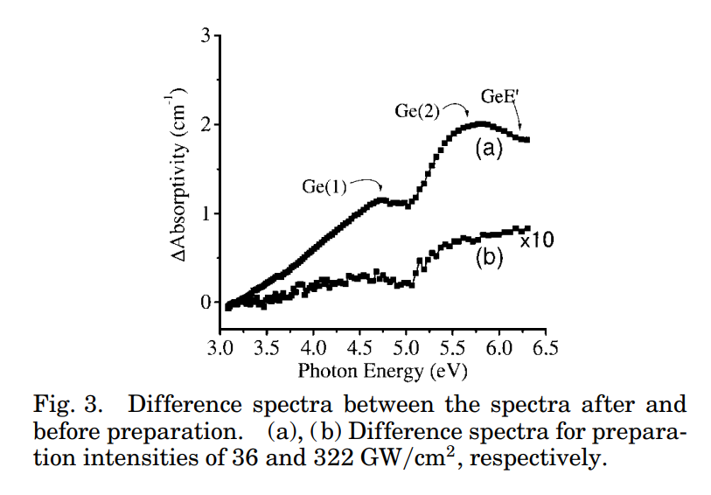
Defect State for GeO₂-SiO₂
J Si, K Kitaoka, J Qiu, T Mitsuyu, K Hirao Optics letters, 1999•opg.optica.org
J Nishii, K Fukumi, H Yamanaka, K Kawamura, H Hosono, H Kawazoe
Physical Review B, 1995•APS
5.7
6.3
4.7
after
5.1
before
As shown in Fig. 3, some new bands located near 4.7, 5.7, and 6.3 eV were induced after the SHG preparation, which are assigned, respectively, to the absorption of a Ge electron trapped center (GEC) [Ge(1) or Ge(2)] and a GeE0 center of 10-GeO2 90-SiO2 glasses based on earlier studies.16

Slide 31
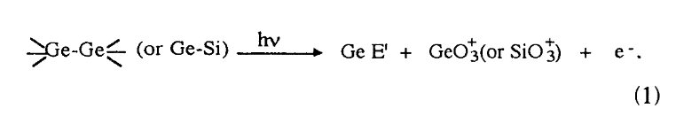
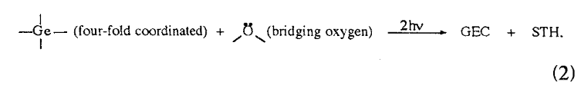
People’s understanding(1995)
J Si, K Kitaoka, J Qiu, T Mitsuyu, K Hirao - Optics letters, 1999 - opg.optica.org
Defect state as donor:
Defect state as receiver:

Slide 32
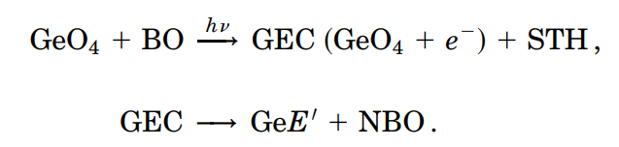




People’s understanding keeps updating(1999)
J Si, K Kitaoka, J Qiu, T Mitsuyu, K Hirao - Optics letters, 1999 - opg.optica.org
GeE' Center: Neutral, oxygen-deficient, and formed as incidental defects.
GEC: Negatively charged, electron-trapped centers formed through intentional excitation and trapping processes.
This is still a postulation

Slide 33
What is Defect 1(Donor)? Lone Pair in Bridging Oxygen
What is Defect 2(Receiver)? GeO₄ ‘s Ge

Slide 34
Trap site for GeO₂-SiO₂
Donor does not donate electrons :
What is Defect 1? There are two defects states: Ge(1) and Ge(2). Ge(1),4.7ev, is from Electron Pair in Bridging Oxygen
Can I engineer it to get it closer to the conduction band?
Receiver failed or too easy to lose electrons:
What is Defect 2? GeO₄ ‘s Ge
What is its density?
How easily is it to excite electrons away from it?
CB
5.1 ev
9 ev
Defect 1
3.8 ev
NB
Popular belief: Oxygen Vacancy around the Ge atom
Notes:
matched χ(2)\chi^{(2)}χ(2) grating in the fiber (L2ω∝A2P0nL_{2\omega} \propto A^2P_0^nL2ω​∝A2P0n​), and then some of this light is absorbed through two-photon absorption (∝P02\propto P_0^2∝P02​). This TPA would, in this picture, result in the release of the trapped charges which are responsible for the internal macroscopic dc field that gives rise to the χ(2)\chi^{(2)}χ(2). Since the effect is almost absent in fiber B, we presume that such TPA is germania related. Note that the erasure process of Ouellette et al., described by Eq. (1), which is quartic in the green power as compared with our quadratic dependence, is ignored in Eq. (2) due to the relative weakness of the generated SH, as compared with the seed green intensity.
A broad linear absorption band centered at 245 nm is known to exist in germania glass, and is well placed for TPA of the 532 nm light. While the defect structure responsible for this band is still the subject of discussion, it is considered to be due to an oxygen vacancy neighboring a Ge atom. This therefore suggests that the origin of the decay might be related to the local environment of the Ge atoms. Bonds such as −Ge−Ge−-Ge-Ge-−Ge−Ge− or −Ge−Si−-Ge-Si-−Ge−Si− are weaker than other bonds in silica glass (such as −Si−O−Si−-Si-O-Si-−Si−O−Si−), and may therefore be more easily affected by TPA of the 532 nm light. Furthermore, it should be noted that while the 1064 nm and 532 nm light together can create the SHG grating, the 1064 nm light alone erases the SHG grating in fiber A. For the SHG from irradiated fibers to be a function of the IR power, the grating has to be stable over the writing period.
The slope of the curves from 2(b), plus additional data vs 1064 nm power used during the reading phase of fiber A. The solid line is the result of a linear least-squares fit.
In conclusion, we have investigated SHG in a high germania content fiber, seeded with Q-switched mode-locked pulses at 532 and 1064 nm. The SHG from the fiber was observed to decay upon exposure to 1064 nm light alone, which we have not observed over short times in fibers with low GeO2 content. The decay rate was proportional to the fourth power of the 1064 nm power, which is consistent with a model based on TPA of the generated SH light. This result suggests that the germania is important in the decay. To obtain more stable SHG in fibers, and to understand its formation mechanism, it appears necessary to investigate the SHG of optical fibers with various GeO2 concentrations.
This research was supported by the Air Force Office of Scientific Research under AFOSR-87-0344, and by NTT laboratories. We wish to thank M. Shimizu of NTT laboratories for providing fiber B.

Slide 35
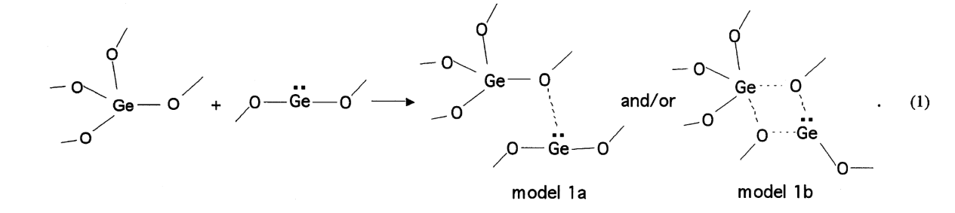
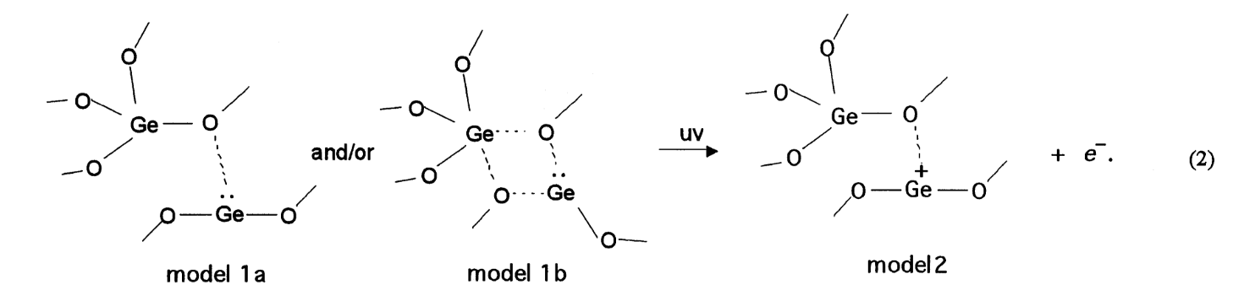
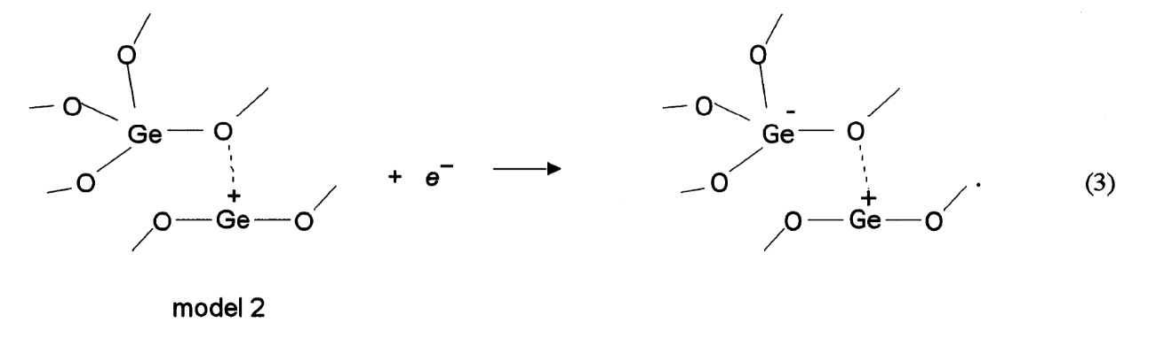
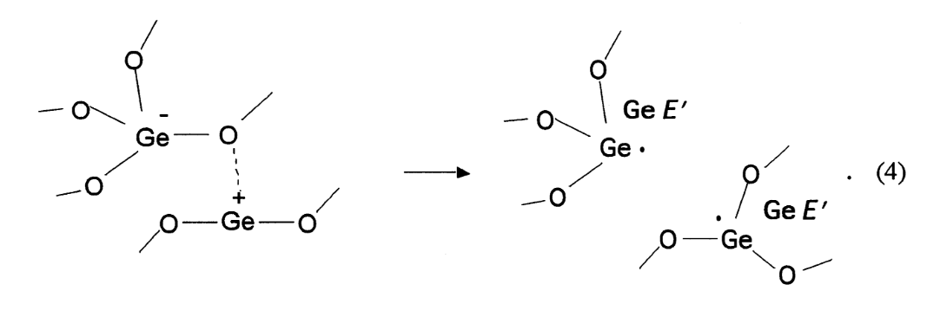


ab initio quantum-chemical calculations—different model
T Uchino, M Takahashi, T Yoko - Physical Review Letters, 2001 - APS

Slide 36
For the remaining questions
I need more time and more wisdom from others
If we could engineer the material, to get a band diagram we want.
I.e. if we want to do it at 1550, could we engineer it, to obtain two defect states as a capacitor?
I.e. if we fail to see it under 1064, could we engineer it,
to make the two defect states favor our reaction?

Slide 37
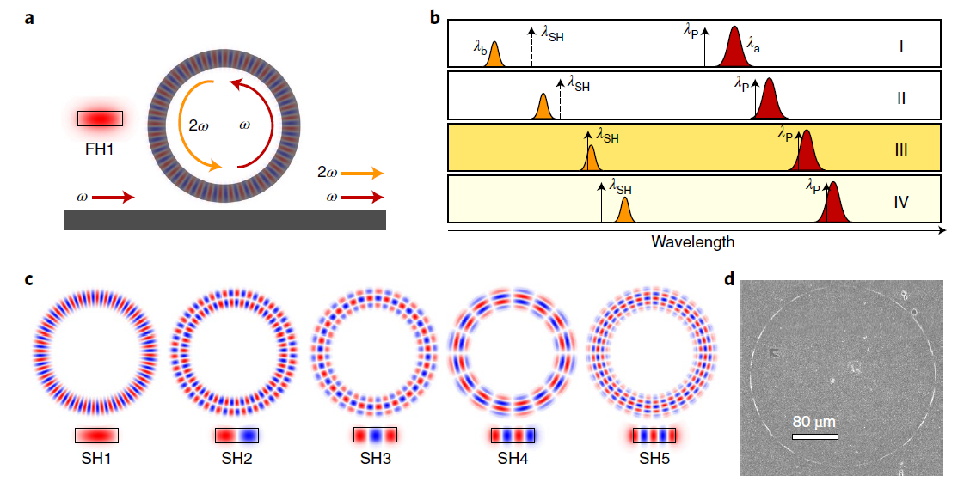
I cite this one from Haojing’s slide
WDM
WDM
532nm in
532nm out
Quasi-phase-matching photo galvanic SHG
1064nm out
1064nm in
U taper
Microring
Heating by TEC
1064nm: pump, write grating
532nm: seed, monitor resonance match
Heater: align resonances of two wavelength
2022 Nature Photon.

Slide 40
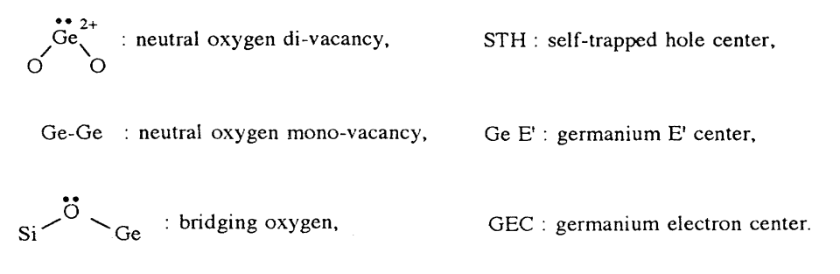
Jargon Definition 2
NOMV := Neutral Oxygen Monovacancy ; Donor ; absorb 5 ev
NODV := Neutral Oxygen Divacancy ; Donor ; emit 3.2/4.3 ev
Ge E’ := Germanium E' Center; Oxygen-deficient center; Donor; absorb 6.4ev
GEC := Germanium Electron Center ; receiver ; absorb 4.4/5.8 ev
GLPC := germanium atom with a lone pair of electrons ; recever ; 5.16 ev
5GeO₂-95SiO₂

Slide 41
07/12/2024
Comsol Simulation-Group Velocity Matching
Measure lens fiber coupling efficiency
Pump the waveguide with MZM + YDFD (no green light still)
TEC
Tsunami

Slide 42
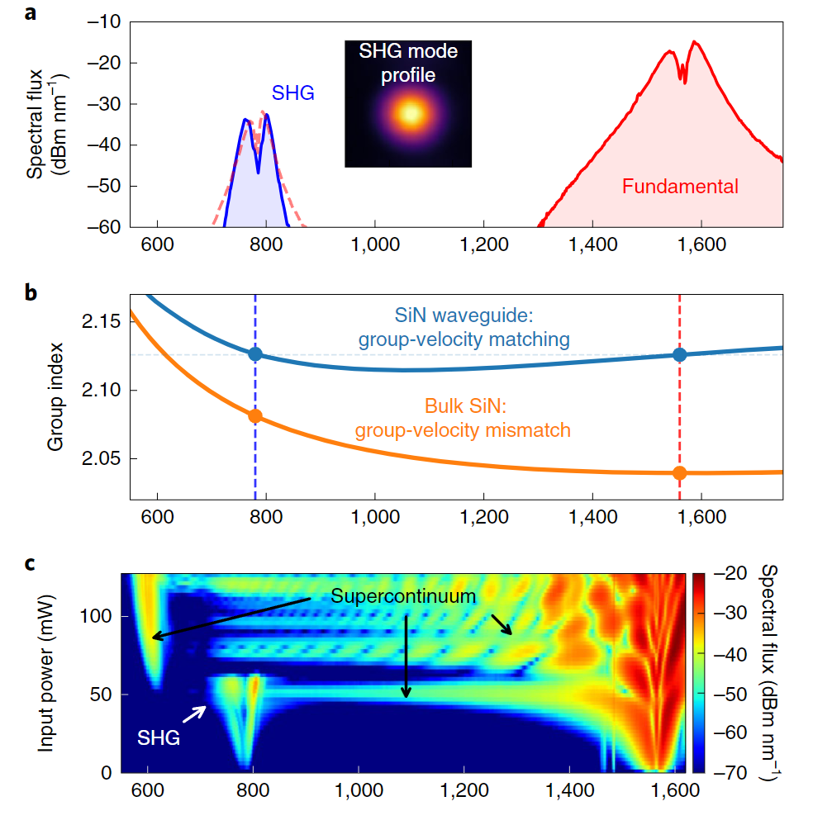
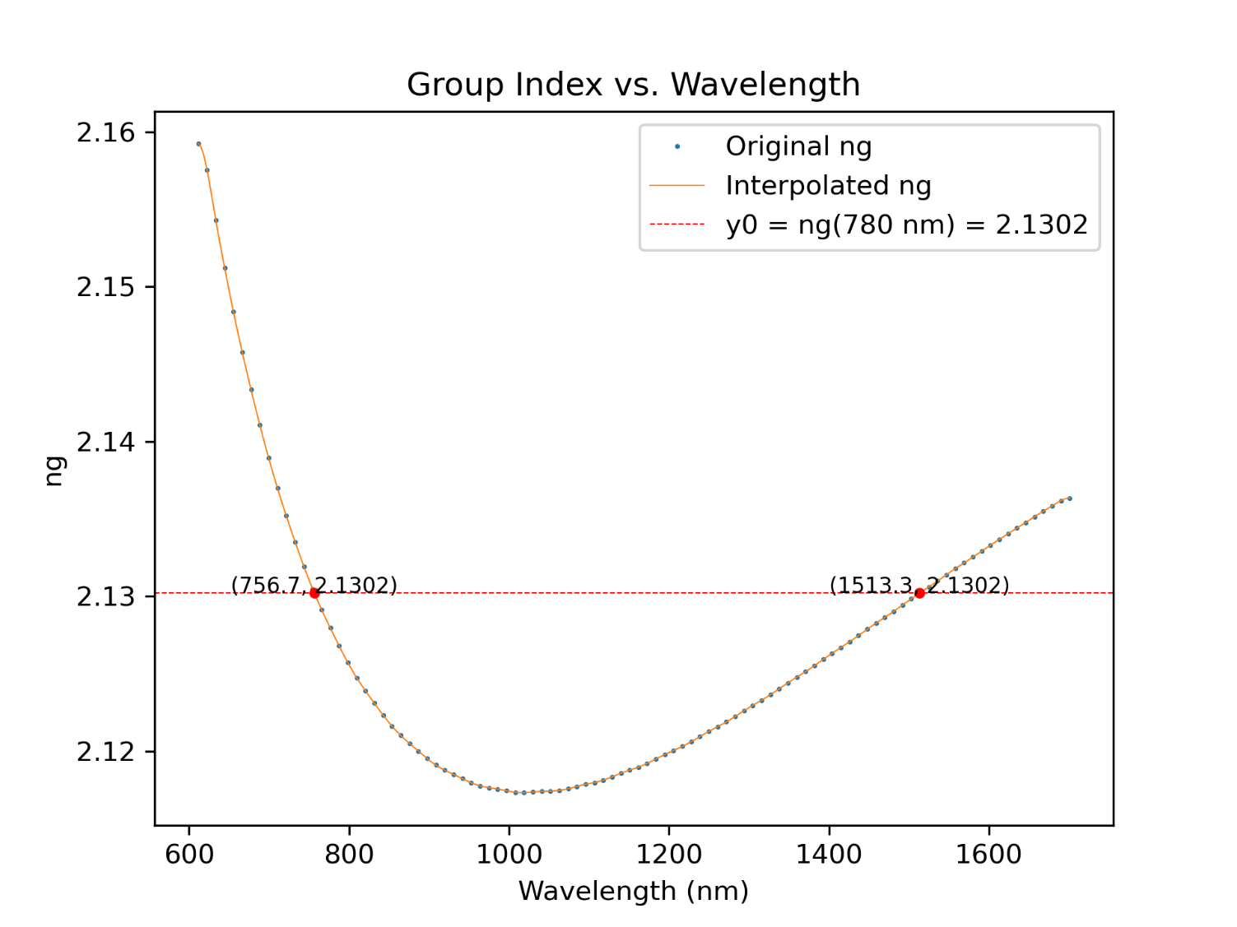
Comsol Simulation – Confirm it with published data in SiN
650*1970 nm

Slide 43


Comsol Simulation – GeO2-SiO2
None of them matches the GVD.
Simulation is wrong
In fiber they do see green light, does fiber meet GVD?
Ge-SiO2 (2% doping RTA) (Shijia-UCSB 2024a: n 0.459-1.688 µm)
FHD

Slide 44
Measure lens fiber coupling efficiency
https://www.ozoptics.com/ALLNEW_PDF/DTS0080.pdf
The best combo now is 5um spot size + 8um waveguide
We currently have:
2 x 1550nm lens fiber
0 x 1064 lens fiber
We need to purchase
4 x 1550nm lens fiber, spot size = 5um
4 x 1064nm lens fiber, spot size = 5um(undetermined)
Roughly 90 dollar each

Slide 45



Pump the waveguide with MZM + YDFD
No green light
Pumped for 4hrs
Power still too weak(8mw after 25db)

Slide 46


Thermoelectric cooler(TEC)
Old TEC cannot converge and heats up extremely quickly
Unable to measure Qabs
The unused TEC we have is too small and unsuitable for Qabs measurement
I still made one based on the small TEC but it takes a year to converge to the setpoint

Slide 47


Tsunami – Current Hunting results
Boxes for ND filter but only boxes
0 x Isolator
0 x Beam Dump

Slide 48




Things to purchase for Tsunami
<Tsunami Power> = 2W
1 x ND kits(79% to 0.01%)
1 x Beam Dump
1 x cover
Isolator is too expensive, and I want to try to find one first

Slide 49
Overall
8 x lens fiber (4 for 1064/ 4 for 1550)
4 x TEC_H3S
1 x Beam Dump
1 x ND filters
1 x cover for Tsunami Safety
Stages or mounts if necessary
Need to find one isolator

Slide 50
07/18/2024

Slide 51

Setup
Act as an attenuator
x 20 lens
Ti: Sapphire
λ/2 Waveplate
Polarization
Beam Splitter
P-polarized
x 40 lens
See later slides
Waveguide/Spiral/Ring
x 60 lens
Average power: 2W
Peak power: 312.5kW
Pulse energy = 25nJ
Repetition rate = 80MHz
S-polarized
AR Coating: 400-700nm
Numerical Aperture v.s. waveguide NA
Backscattering
Beam Dump
We have it, and its parameters match
We have it, but its parameters don’t match
We don’t have it

Slide 52

What kind of measurements’ tool we want?
If fiber:
x 20 lens
Lens Fiber +V groove
Ti: Saphh
λ/2 Waveplate
Polarization
Beam Splitter
P-polarized
x 40 lens
Waveguide/Spiral/Ring
OSA(300-1000nm)
x 60 lens
We only have two left, and Peng will also use it
I want five more
S-polarized
AR Coating: 400-700nm
Numerical Aperture v.s. waveguide NA
Backscattering
Beam Dump
If free space:
We have it, and its parameters match
We have it, but its parameters don’t match
We don’t have it

Slide 53



Summary of what I want to buy
5 x lens fiber
1 x blackout
1 x V groove(For fiber dangling in the air)
If pulses coming out of the waveguide are still too strong, there is a specific component for femtosecond pulse attenuation:
Lead time = 2 weeks

Slide 54




Replicate NC simulation result
1.69
1.06
0.826

Slide 55



Miscellaneous
Can I take things away from NTT stage?
Final report date(I want to work longer!)

Slide 56

1064nm Absorption Q results
Use a degraded device as a test, (3mm ring with 6um width)
$\frac{∂ν}{∂T}=1.5GHz/K$
(use a FHD ring results @1550nm,
waiting new TEC for remeasurement)
$\frac{∂ν}{∂P}=2.49GHz/W$
1064 taper transmission > 97.5%
Need unattach taper to reduce scattering loss
$\frac{∂T}{∂P}=79.45K/W$
Use less mode cavity as possible
$Q_{abs}=2η\frac{\frac{∂ν}{∂T}\frac{∂T}{∂P}}{\frac{∂ν}{∂P}}Q_{L}=339.2M (very rough estimation)$

Slide 57

Mode Lock Controller
CW
A box containing Ti:Sapphire
CW Controller
Optical Parametric Oscillator(Not used)

Slide 58

Two lines that deliver the coolant

Slide 59



Slide 60


Press this

Slide 61


Slide 62



Slide 63





Slide 64





Slide 65





Slide 66
2024/07/26
Ti: Saphh
λ/2 Waveplate
Polarization
Beam Splitter
P-polarized
x 60 lens
Integrating
Sphere
Waveguide/Spiral/Ring
S-polarized
Beam Dump

Slide 67

Current Setup
Effective Couple

Slide 68


Current Setup
Waveguide, 4um x 6um cross section
, Air cladded
6um
GeO-SiO2
4um
Si

Slide 69


Edge
Damage due to pulse laser

Slide 70




Giga confused by the German result
German’s
Mine
Mine

Slide 72


Slide 73
2024/07/31
Skipped

Slide 74











Substrate v.s. height determine where the mode resides

Slide 75


Slide 76
2024/08/09

Slide 77













Vary Base Thickness, Waveguide Height, and Width Comsol Cross Section For Width/High = 2 is Shown
Height/Width =2
2
2
2
2
2
1

Slide 78














2
2
2
1
1
2
2
2

Slide 79
Promising candidate
Vary width from 0.5um to 3.6um
Substrate thickness 500nm or 750nm (or 250nm, this might be too thin)
Waveguide height 500nm or 1000nm

Slide 80



Layer1 for MLA

Slide 81



Layer2 for MLA

Slide 82

Edge Couple Setup
Pin = 1W
Best record: Pout = 200mw(not stable)
Normally: Pout =20mw(could last for 4hours)

Slide 83


Waveguide and Spiral
Nc Super Continuum paper: 2300pj, 30% →690
My for 20mw: 35 000pj, 1%→350

Slide 84


Reduce spot size

